Slide 1
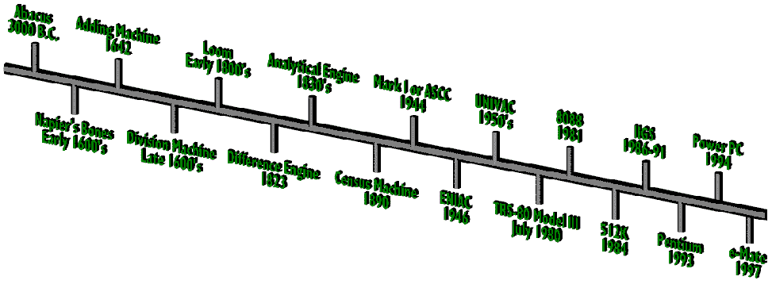
A Brief History of Computers

Slide 2
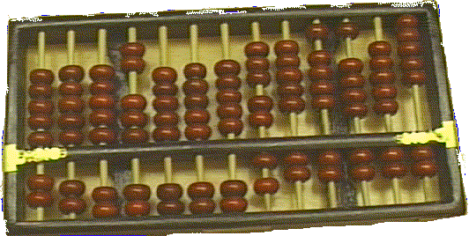
The beginning of computing – Abacus (3000BC)

Slide 3

Babbage’s Differential Engine (1823)

Slide 4
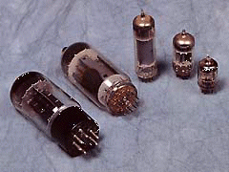

ENIAC (Electronic Numerical Integrator and Computer)
Designed by Mauchly and Eckert
University of Pennsylvania
First general-purpose electronic digital computer
Response to WW2 need to calculate trajectory tables for weapons.
Built 1943-1946 – too late for war effort.
ENIAC DetailsDecimal (not binary)
20 accumulators of 10 digits
Programmed manually by switches
18,000 vacuum tubes
30 tons
15,000 square feet
140 kW power consumption
5,000 additions per second
Vacuum Tube

Slide 5
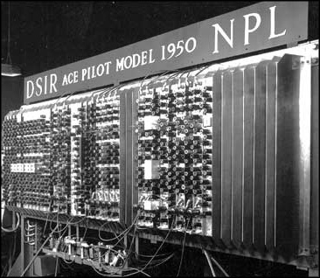
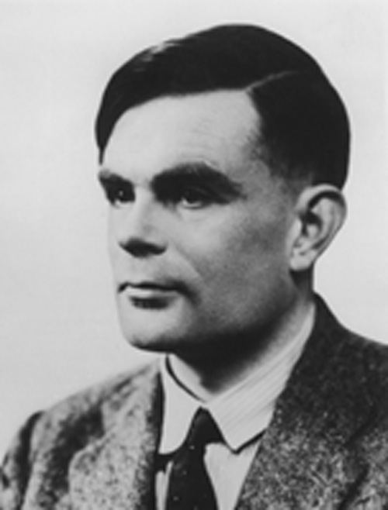
Alan Turing (1912-1954)

Slide 6
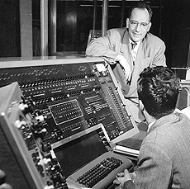
John Mauchly leaning on the UNIVersal Automatic Computer

Slide 7
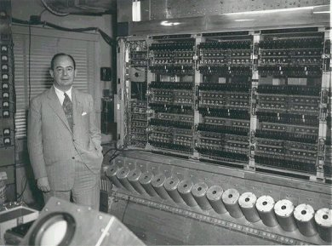
Dr. Von-Neuman with IAS machine
Stored Program Concept
Main memory storing programs and data
ALU operating on binary data
Control unit interpreting instructions from memory and executing
Input and output equipment operated by control unit
Princeton Institute for Advanced Studies (IAS).
Completed 1952

Slide 8
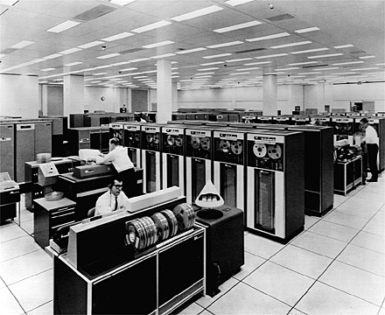
The IBM 7094, a typical mainframe computer

Slide 9
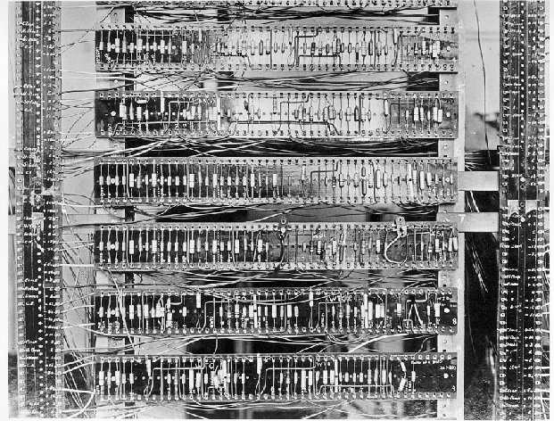
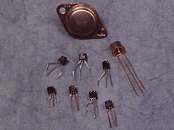
2nd Generation: Transistor Based Computers
Transistors replaced vacuum tubes
Smaller
Cheaper
Less heat dissipation
Made from Silicon (Sand)
Invented 1947 at Bell Labs
William Shockley et al.
Commercial Transistor based computers:
NCR (National Cash Register) & RCA(Radio Corporation of America) produced small transistor machines
IBM 7000
DEC – 1957 (PDP-1)(Programmed data processor)
First transistor computer – Manchester University 1953.

Slide 10
Second Generation (1958-1964)
1958 Philco introduces TRANSAC S-2000
first transistorized commercial machine
IBM 7070, 7074 (1960), 7072(1961)
1959 IBM 7090, 7040 (1961), 7094 (1962)
1959 IBM 1401, 1410 (1960), 1440 (1962)
FORTRAN, ALGOL, and COBOL are first standardized programming languages

Slide 11
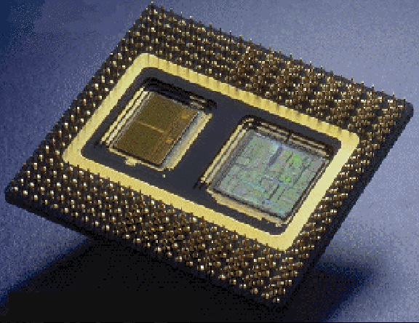
3rd Generation: Integrated Circuits
A single, self-contained transistor is called a discrete component.
Transistor based computers – discrete components manufactured separately, packaged in their own containers, and soldered or wired together onto circuit boards.
Early 2nd generation computers contained about 10,000 transistors – but grew to hundreds of thousands!!!!
Integrated circuits revolutionized electronics.
Silicon Chip – Collection of tiny transistors

Slide 12
Third Generation (1964-1971)
April 1964 IBM announces the System/360
solid logic technology (integrated circuits)
family of “compatible” computers
1964 Control Data delivers the CDC 6600(control data corporation)
nanoseconds
telecommunications
BASIC, Beginners All-purpose Symbolic Instruction Code

Slide 13
Fourth Generation (1971- )
Large scale integrated circuits (MSI, LSI)
Nanoseconds and picoseconds
Databases (large)
Structured languages (Pascal)
Structured techniques
Business packages

Slide 14
Generations of Computers
Vacuum tube - 1946-1957 (One bit ➔ Size of a hand)
Transistor - 1958-1964 (One bit ➔ Size of a fingernail)
Small scale integration - 1965 on Up to 100 devices on a chip
Medium scale integration - to 1971 100-3,000 devices on a chip
Large scale integration - 1971-1977 3,000 - 100,000 devices on a chip
Very large scale integration - 1978 to date 100,000 - 100,000,000 devices on a chip
Ultra large scale integration Over 100,000,000 devices on a chip
Thousands of bits on the size of a hand
Millions of bits on the size of a fingernail.

Slide 16
Definition
Introduction
Computer architecture is defined by computer structure and behavior as seen by their programmer that uses machine language instructions.
This includes the instruction formats, addressing modes, instruction set and general organization of the CPU registers

Slide 17
Organization of Von-Neumann Machine (IAS Computer)
The task of entering and altering programs for ENIAC was extremely tedious
Stored program concept – says that the program is stored in the computer along with any relevant data
A stored program computer consists of a processing unit and an attached memory system.
The processing unit consists of data-path and control. The data-path contains registers to hold data and functional units, such as arithmetic logic units and shifters, to operate on data.

Slide 18
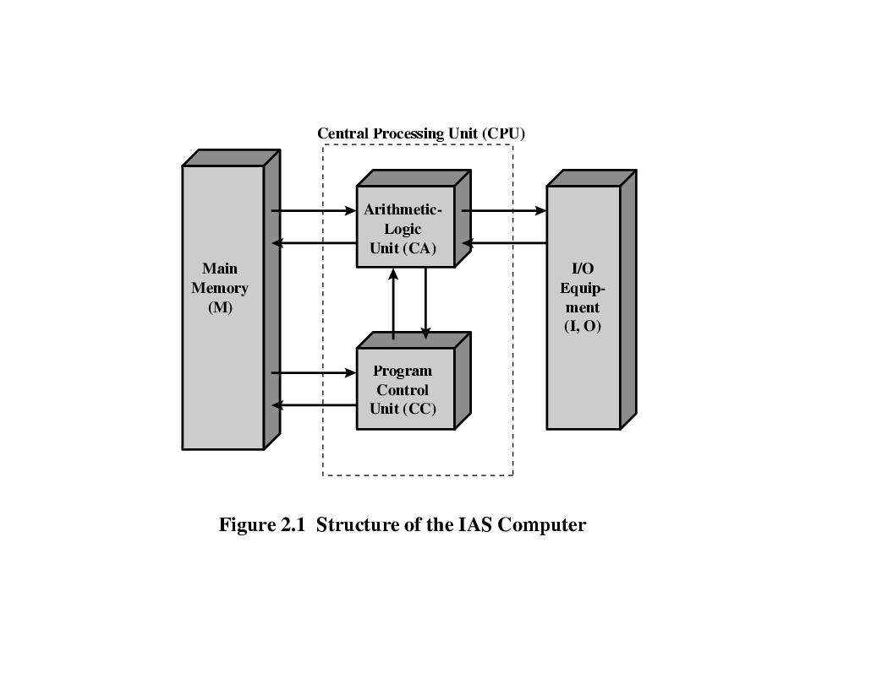
Structure of Von Neumann Machine

Slide 19
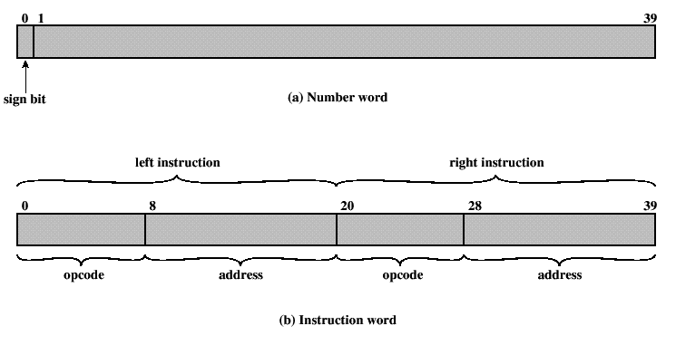
Memory of the IAS
1000 storage locations called words.
Each word 40 bits.
A word may contain:
A numbers stored as 40 binary digits (bits) – sign bit + 39 bit value
An instruction-pair. Each instruction:
An opcode (8 bits)
An address (12 bits) – designating one of the 1000 words in memory.

Slide 20
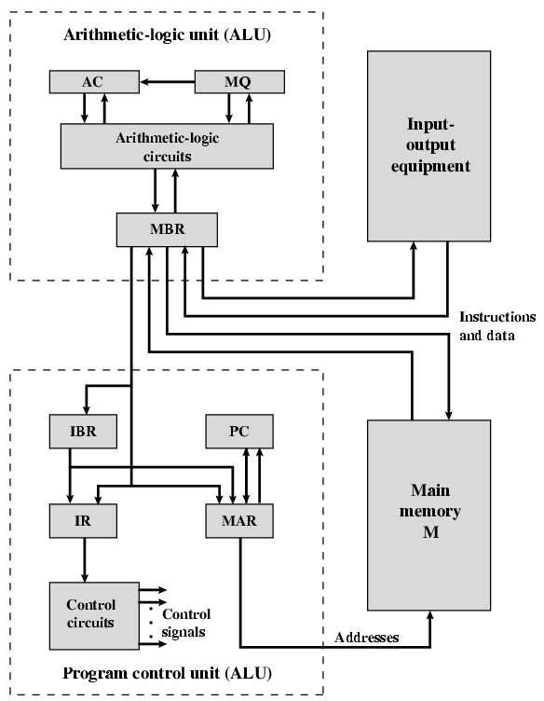
Von Neumann Machine
MBR: Memory Buffer Register - contains the word to be stored in memory or just received from memory.
MAR: Memory Address Register - specifies the address in memory of the word to be stored or retrieved.
IR: Instruction Register - contains the 8-bit opcode currently being executed.
IBR: Instruction Buffer Register - temporary store for RHS instruction from word in memory.
PC: Program Counter - address of next instruction-pair to fetch from memory.
AC: Accumulator & MQ: Multiplier quotient - holds operands and results of ALU ops.
AC
MQ
MBR
IBR
PC
IR
MAR

Slide 21
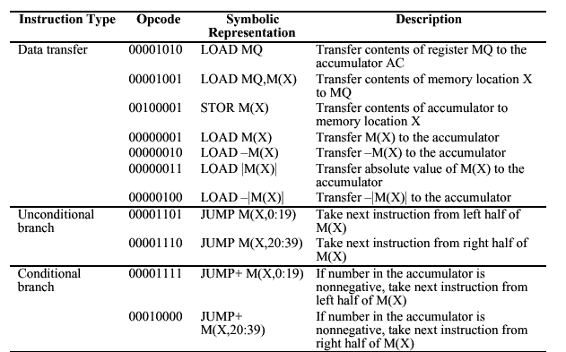
IAS Instruction set

Slide 22
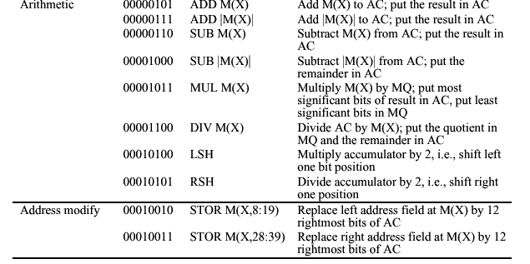
IAS Instruction set (continued)
Example of an Instruction-pair.
Load M(100), Add M(101) 0000000100011111010000000101000111110101

Slide 23
AC = 7
AC = 3
MEMORY
1. LOAD M(X) 500, ADD M(X) 501
2. STOR M(X) 500, (Other Ins)
.....
3
4
AC
MQ
500
MBR = 4
LOAD M(X)
MBR
MBR = 3
500
ADD M(X) 501
(Other Ins)
STOR M(X)
PC
1
2
MAR
1
500
501
2
500
MBR
LOAD M(X) 500, ADD M(X) 501
3
4
STOR M(X) 500, (Other Ins)
IR
LOAD M(X)
ADD M(X)
STOR M(X)
IBR
ADD M(X) 501
(Other Ins)
AC
3
501
PC = 2
7
IBR
PC = 1
Add M(X)
Mar ← PC
MAR ←PC
3
LOAD M(X) 500, ADD M(X) 501
4
IR
MAR = 2
STOR M(X) 500, (Other Ins)
MAR = 501
MAR = 1
MAR = 500
MAR =500
add = 501
add = 1
add = 500
add = 2

Slide 24
INSTRUCTION FORMAT
Instruction Format
Instruction Fields
OP-code field - specifies the operation to be performed
Address field - designates memory address(s) or a processor register(s)
Mode field - specifies the way the operand or the
effective address is determined
The number of address fields in the instruction format
depends on the internal organization of CPU
- The three most common CPU organizations:
Single accumulator organization:
ADD X /* AC ← AC + M[X] */
General register organization:
ADD R1, R2, R3 /* R1 ← R2 + R3 */
ADD R1, R2 /* R1 ← R1 + R2 */
MOV R1, R2 /* R1 ← R2 */
ADD R1, X /* R1 ← R1 + M[X] */
Stack organization:
PUSH X /* TOS ← M[X] */
ADD

Slide 25
THREE, and TWO-ADDRESS INSTRUCTIONS
Three-Address Instructions:
Program to evaluate X = (A + B) * (C + D) :
ADD R1, A, B /* R1 ← M[A] + M[B] */
ADD R2, C, D /* R2 ← M[C] + M[D] */
MUL X, R1, R2 /* M[X] ← R1 * R2 */
- Results in short programs
- Instruction becomes long (many bits)
Two-Address Instructions:
Program to evaluate X = (A + B) * (C + D) :
MOV R1, A /* R1 ← M[A] */
ADD R1, B /* R1 ← R1 + M[B] */
MOV R2, C /* R2 ← M[C] */
ADD R2, D /* R2 ← R2 + M[D] */
MUL R1, R2 /* R1 ← R1 * R2 */
MOV X, R1 /* M[X] ← R1 */

Slide 26
ONE, and ZERO-ADDRESS INSTRUCTIONS
One-Address Instructions:
- Use an implied AC register for all data manipulation
- Program to evaluate X = (A + B) * (C + D) :
LOAD A /* AC ← M[A] */
ADD B /* AC ← AC + M[B] */
STORE T /* M[T] ← AC */
LOAD C /* AC ← M[C] */
ADD D /* AC ← AC + M[D] */
MUL T /* AC ← AC * M[T] */
STORE X /* M[X] ← AC */
Zero-Address Instructions:
- Can be found in a stack-organized computer
- Program to evaluate X = (A + B) * (C + D) :
PUSH A /* TOS ← A */
PUSH B /* TOS ← B */
ADD /* TOS ← (A + B) */
PUSH C /* TOS ← C */
PUSH D /* TOS ← D */
ADD /* TOS ← (C + D) */
MUL /* TOS ← (C + D) * (A + B) */
POP X /* M[X] ← TOS */

Slide 27
ADDRESSING MODES
Addressing Modes:
* Specifies a rule for interpreting or modifying the
address field of the instruction (before the operand
is actually referenced)
* Variety of addressing modes
- to give programming flexibility to the user
- to use the bits in the address field of the
instruction efficiently

Slide 28
Types of addressing modes
Implied
Immediate
Register
Register Indirect
Auto Increment or Auto Decrement
Direct
Indirect
Relative
Index
Base Register

Slide 29
Implied:-
No address field
Operands are specified implicitly in the definition of instruction.
EX: Complement accumulator CMA,INC,DEC
Zero address inst in stack organization.
Immediate:-
An immediate mode inst has an operand field rather than an address field.
Operand field contains the actual operand to be used in conjunction with the operation specified in the inst
Mov R1,#200

Slide 30
Register Address mode:-
Operand are in registers that reside within the CPU.
Ex: MOV R1,R2
Register Indirect address:-
In the mode the inst specifies a register in the CPU whose content give the address of the operand in memory.
Eg: MOV R1,(R2)

Slide 31
Auto increment or Auto decrement:-
Similar to register indirect mode except that the register is incremented or decrement after its value is used to access memory.
2 forms post and pre :-
Mov R1,(R2)+ → post increment
Mov R1,+(R2) → pre increment
Mov R1,(R2)- → post decrement
Mov R1,-(R2) → post decrement

Slide 32
Direct :-
Address field contains the direct address of the operands.
MOV R1,2000
Indirect address mode:
the address field of the inst gives address where the effective address is stored in memory.
Effective address:-
memory address obtained from the computation dictated by the given addressing mode. It is the address of the operand in a computational type inst
MOV R1,(2000)

Slide 33
Relative:-
Program counter value +address field → effective address
LOAD R1,$ADR.
Index:-
In this mode the content of an index register is added to the address part of inst to obtain the effective address.
LOAD ADR(x)
Base Reg:-
Base Reg +Address field→ effective address
Index Reg→ holds the index number
Base Reg→holds the base address & address field gives the displacement.

Slide 34
ADDRESSING MODES - EXAMPLES
Address
Memory
200
Load to AC Mode
PC = 200
201
Address = 500
202
Next instruction
R1 = 400
XR = 100
399
450
400
700
AC
500
800
600
900
Addressing
Mode
Effective
Address
Content
of AC
Direct address 500 /* AC ← (500) */ 800
Immediate operand - /* AC ← 500 */ 500
Indirect address 800 /* AC ← ((500)) */ 300
Relative address 702 /* AC ← (PC+500) */ 325
Indexed address 600 /* AC ← (XR+500) */ 900
Register - /* AC ← R1 */ 400
Register indirect 400 /* AC ← (R1) */ 700
Autoincrement 400 /* AC ← (R1)+ */ 700
Autodecrement 399 /* AC ← -(R) */ 450
702
325
800
300

Slide 35
Instruction types

Slide 36
DATA TRANSFER INSTRUCTIONS
Typical Data Transfer Instructions
Name Mnemonic
Load LD
Store ST
Move MOV
Exchange XCH
Input IN
Output OUT
Push PUSH
Pop POP
Data Transfer Instructions with Different Addressing Modes
Mode
Assembly
Convention
Register Transfer
Direct address LD ADR AC ← M[ADR]
Indirect address LD @ADR AC ← M[M[ADR]]
Relative address LD $ADR AC ← M[PC + ADR]
Immediate operand LD #NBR AC ← NBR
Index addressing LD ADR(X) AC ← M[ADR + XR]
Register LD R1 AC ← R1
Register indirect LD (R1) AC ← M[R1]
Autoincrement LD (R1)+ AC ← M[R1], R1 ← R1 + 1
Autodecrement LD -(R1) R1 ← R1 - 1, AC ← M[R1]

Slide 37
DATA MANIPULATION INSTRUCTIONS
Three Basic Types:
Arithmetic instructions
Logical and bit manipulation instructions
Shift instructions
Arithmetic Instructions
Name Mnemonic
Increment INC
Decrement DEC
Add ADD
Subtract SUB
Multiply MUL
Divide DIV
Add with Carry ADDC
Subtract with Borrow SUBB
Negate(2’s Complement) NEG
Logical and Bit Manipulation Instructions
Shift Instructions
Name Mnemonic
Name Mnemonic
Clear CLR
Complement COM
AND AND
OR OR
Exclusive-OR XOR
Clear carry CLRC
Set carry SETC
Complement carry COMC
Enable interrupt EI
Disable interrupt DI
Logical shift right SHR
Logical shift left SHL
Arithmetic shift right SHRA
Arithmetic shift left SHLA
Rotate right ROR
Rotate left ROL
Rotate right thru carry RORC
Rotate left thru carry ROLC

Slide 38
Subroutine Call and Return Mechanisms
Subroutine is a self-contained sequence of instructions that performs a given computational task.
It may be called many times at various points in the main program
When called, branches to 1st line of subroutine and at the end, returned to main program.
Different names to the instruction that transfers program control to a subroutine
Call subroutine
Jump to subroutine
Branch to subroutine
Branch and save address

Slide 39
Trace the given program
Void Main() //Main() is the faculty
{
say good morning;
Write “Introduction”;
call “student1”;
Write “Thankyou”;
}

Slide 40
Continue Tracing
Void student1()
{
say nursery rhyme;
Write “Computer Architecture”;
call “student2”;
Write your School name;
}

Slide 41
Continue Tracing
Void student2()
{
act like vegetable vendor;
Write “B1 slot”;
call “student3”;
Write your branch;
}

Slide 42
Continue Tracing
Void student3()
{
Sing a song;
Write your name;
}

Slide 43
Subroutine call
CALL
SP ← SP – 1 decrement SP
M[SP] ← PC Push content of PC into stack
PC ← Effective Address (EA) Transfer control to subroutine.
RTN
PC ← M[SP] POP stack and transfer to PC.
SP ← SP + 1 Inc SP
Recursive subroutine is a subroutine that calls itself.

Slide 44
Recursive subroutines
Subroutine that calls itself
If only one register or memory location is used to hold the return address, when subroutine is called recursively, it destroys the previous return address.
So, stack is the good solution for this problem

Slide 45
Instruction fetch and Execute
The fetched instruction is loaded into a register in the processor is called as instruction register(IR).
Category of Actions :
Processor memory:
Data may be transferred from processor to memory or from memory to processor.

Slide 46
Cont..
2. Processor I/O:
Data may be transferred to or from a peripheral device by transferring between the processor and I/O module.
3. Data processing:
The processor may perform some arithmetic or logic operation on data.
4. control:
An instruction may specify the sequence of execution be altered.

Slide 47
Basic Instruction cycle
Fetch cycle Execute cycle
Start
Fetch next instruction
Execute instruction
Halt

Slide 48
1. Instruction format
15
0 3 4
2.Integer format
0 S 1 15
Opcode Address
Magnitude

Slide 49
Cont..
3. Internal CPU registers:
Program counter(PC)- Address of instruction
Instruction Register (IR)- Instruction being executed
Accumulator(AC)- Temporary register.
Partial list of opcodes:
0001- Load AC from memory
0010- Store AC from memory
0101- Add to AC from memory

Slide 50
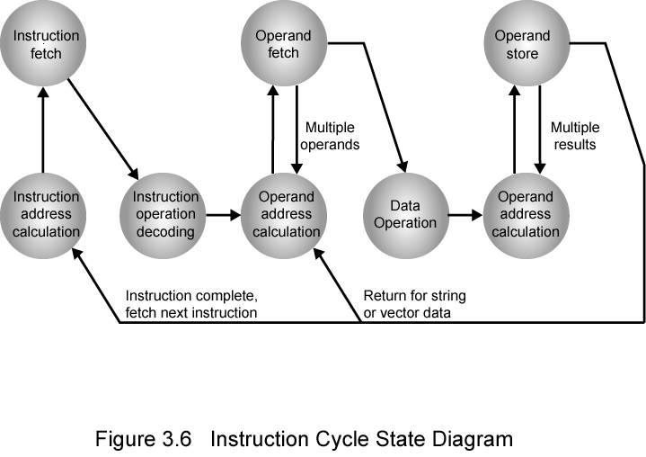
Instruction Cycle State Diagram

Slide 51
Instruction state cycle diagram (cont..)
Instruction address calculation (iac):
Determine the address of the next instruction to be executed. Adding a fixed number to a next number.
Instruction fetch: (if)
Read the instruction from its memory location into the processor.
Instruction operation decoding: (iad)
Analyze instruction to determine type of operation to be performed and operand(s) to be used.
Operand Address Calculation: (oac)
If the operation involves the reference to an operand in memory or available via I/O, then determine the address of the operand.
Operand Fetch (of):
Fetch the operand from memory or read it from I/O.
Data Operation (do):
Perform the operation indicated in the instruction.
Operand store (os)
Write the result into memory or out to I/O.

Slide 52
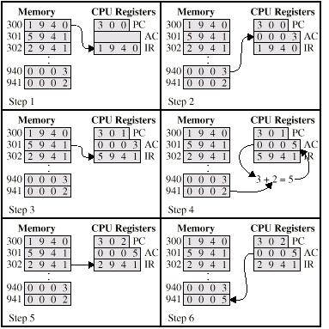

Example of Program Execution

Slide 53
Program interrupt
Program interrupt refers to transfer of program ctrl from currently running program to another service program as a result of external or internal generated request.
Interrupt is usually initiated by an internal or external signal rather from execution of inst.
Address of ISR (Interrupt Service Routine) is determined by H/W rather from address field.

Slide 54
Cont..
PSW (program status word)
Collection of all status bit conditions in the CPU is called PSW.
It is a hardware register and contains status information that characterizes state of CPU.

Slide 55
PROGRAM INTERRUPT
Types of Interrupts:
External interrupts
External Interrupts initiated from the outside of CPU and Memory
- I/O Device -> Data transfer request or Data transfer complete
- Timing Device -> Timeout
- Power Failure
Internal interrupts (trap)
Internal Interrupts are caused by the currently running program
- Register, Stack Overflow
- Divide by zero
- OP-code Violation
- Protection Violation
Software Interrupts
Both External and Internal Interrupts are initiated by the computer Hardware.
Software Interrupts are initiated by executing an instruction.
- Supervisor Call -> Switching from a user mode to the supervisor mode
-> Allows to execute a certain class of operations
which are not allowed in the user mode

Slide 56
Register and Register Files

Slide 57
Cont..
An m- bit register is an ordered set of m flip flops designed to store m word. (z0… zm-1)
Each bit is stored in separate flip flops.
All flip flops have common control line.(clk, clear)
Registers can be made up of various flip flops.
diagram

Slide 58
Cont…
Register z reads in the data word x each time it is clocked. To maintain the contents of z constant, z inputs bus should be enabled always.
Parallel load: diagram
introduce a control line load, which causes the register to read in the current value of x when it is clocked and load=1, if load=0 the previous value is retained in the register.

Slide 59
Shift register
Transfer the contents into and from register 1bit at a time.
M- bit shift register consists of m flip flops each of which is connected to its left or right neighbor.
Data can be entered 1 bit at a time at one end of register and can be removed 1 bit at a time
from the other end known as serial i/p –o/p.
diagram

Slide 60
Cont..
Right shift is accomplished by activating the shift enable line connected to the clk input of each flip flop.
Right shift operation changes the registers state as,
(Xzm-1 zm-2…z1):=(zm-1 zm-2,….z1,z0)
Left shift operation changes the register state as (zm-2 zm-3…z0,x):=(zm-1 zm-2,….z1,z0)

Slide 61
Register files
Set of general purpose registers r0:rm-1 known as register file RF.
Each register Ri is individually addressable.
Arithmetic logic instruction take two ,three address format.
R2=f(R1,R2)- 2 address
R3=f(R1,R2)- 3 address

Slide 62
Cont..
Intermediate results are stored in processor with the help of register.
RF functions as a RAM.
RF differs from M becomes RF requires 2 or more operands accessed simultaneously.
RF is also known as multiport RAM

Slide 63
A register file with three access ports - symbol
Data in C
16
2
Address C
Port C
Register File
RF
2
2
Address A
Port A
Port B
Address B
16
16
Data out A
Data out B

Slide 64
A Register File with three access ports – logic diagram
Ex: R3 ← R1 + R2
Read Address A = 01
Read Address B = 10
Write Address C = 11
Data in C
16
11
2
Write
address C
4-way 16-bit
demultiplexer
S
16
16
16
16
16-bit register R3
16-bit register R2
16-bit register R1
16-bit register R0
0101
16
16
●
16
●
●
16
●
2
4-way 16-bit
multiplexer
4-way 16-bit
multiplexer
2
01
S
S
Read
address A
Read
address B
16
16
Data out A
Data out B

